Slide 1

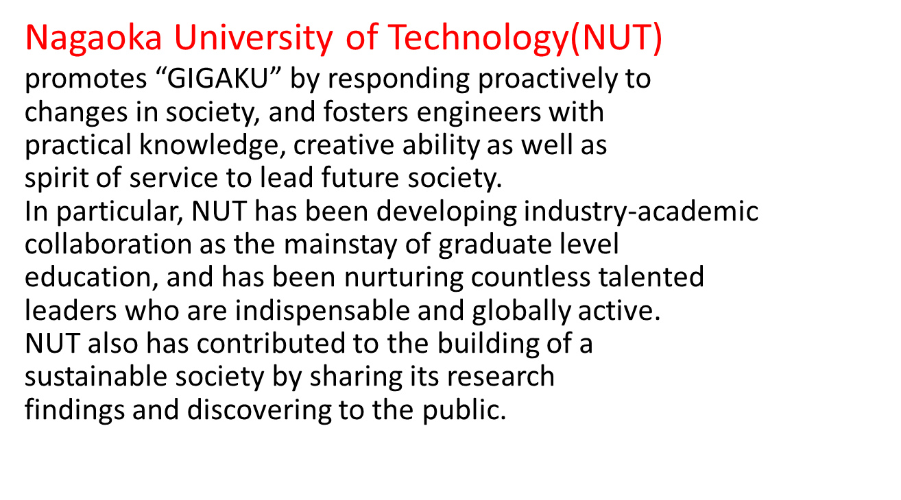

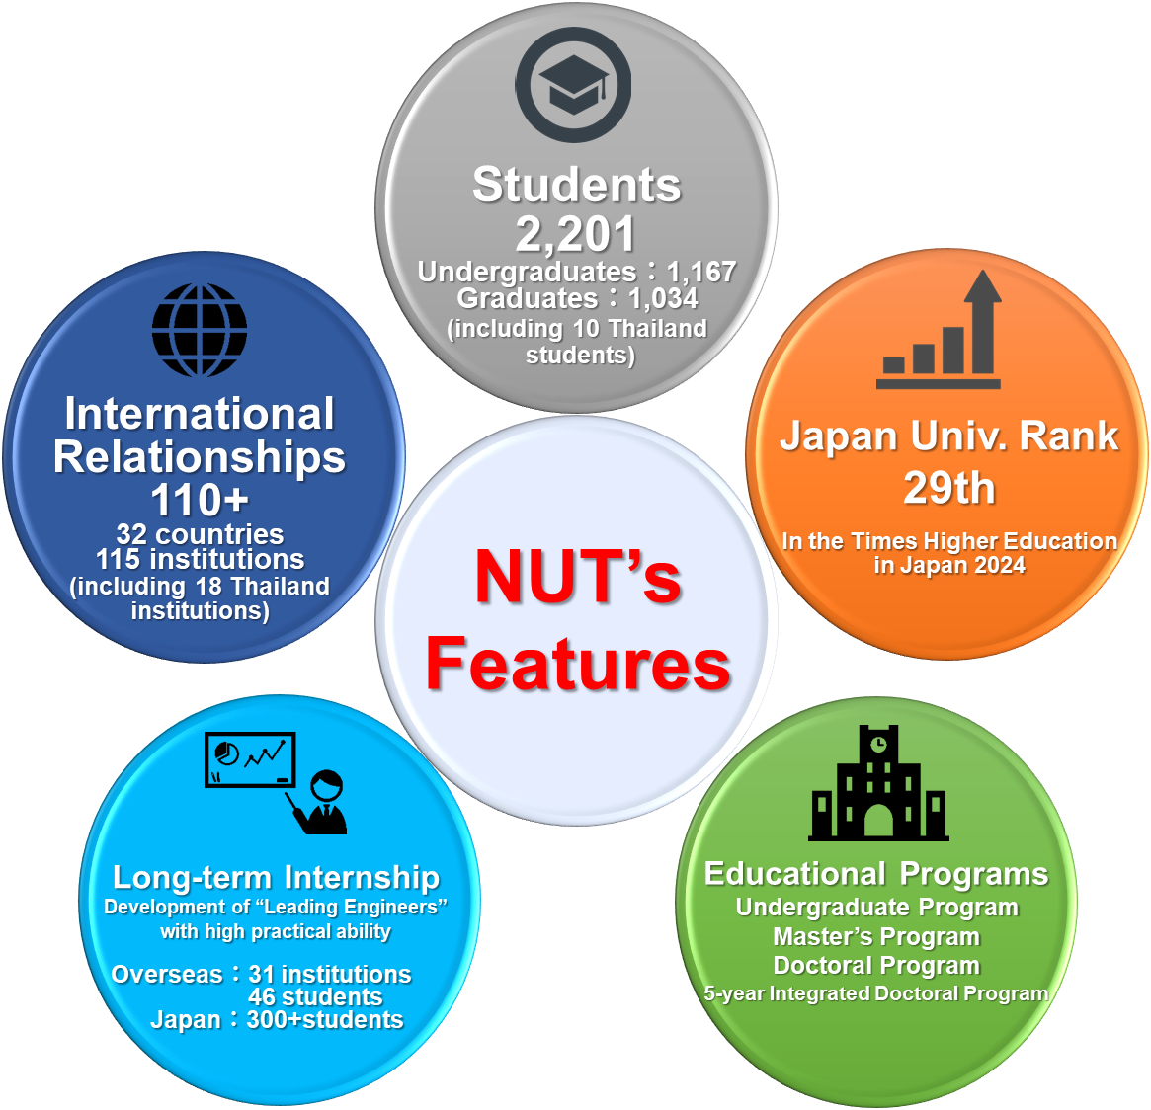




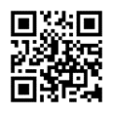
Nagaoka University of Technology
Basic Information (As of May 1, 2025)
NUT offers Bachelor, Master and Doctoral degree programs in the following technical fields:
・Mechanical Engineering
・Electrical, Electronics and Information Engineering
・Information and Management Systems Engineering
・Materials Science and Bioengineering
・Civil and Environmental Engineering
・Nuclear Technology
・System Safety Engineering
・Science of Technology Innovation
◆ Number of Students and Staff
- Students 2,201 (Undergraduates 1,167, Graduates 1,034)
- Staff 364 (Faculty members 211, Others 153)
◆ Number of Int’l Students
- 254 (11.5% of all the students at NUT)
［including 11 Thailand students］
◆ Int’l Exchange Agreements
- with 115 institutions of 32 countries
［18 institutions in Thailand］
OUTLINE and MISSION of NUT
United Nations Academic Impact Hub for SDG9 (2018.10~)
NUT was appointed to a United Nations Academic Impact (UNAI) Hub for SDG 9 (Industry, Innovation and Infrastructure) as an exemplar of an innovative approach to the SDGs in October, 2018.
Furthermore, NUT was appointed as UNAI Hub University for second consecutive hub in 2021.
Among 1,400 UNAI members including universities and institutions, NUT had been the only appointment from East Asia in the first and second term.
NUT has been appointed as UNAI SDG 9 Hub University for third consecutive term (2025~2027) in 2025.
Overseas Office in Thailand at CU
1) Enhancing research and educational collaborations between Nagaoka
University of Technology and Thailand universities.
2) Fostering global academia and industry cooperation through the
international cooperative education network
3) Support for the acceptance and dispatch of students and faculty members
through education programs
4) Creating sustainable and cooperative environment in the overseas
strategic region
Contact : Room 405 Sci5 bldg, Faculty of Science,
Chulalongkorn Universty, 10330 THAILAND
Email : gigakutp_Bangkok@vos.nagaokaut.ac.jp

