Slide 1

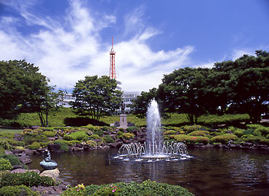
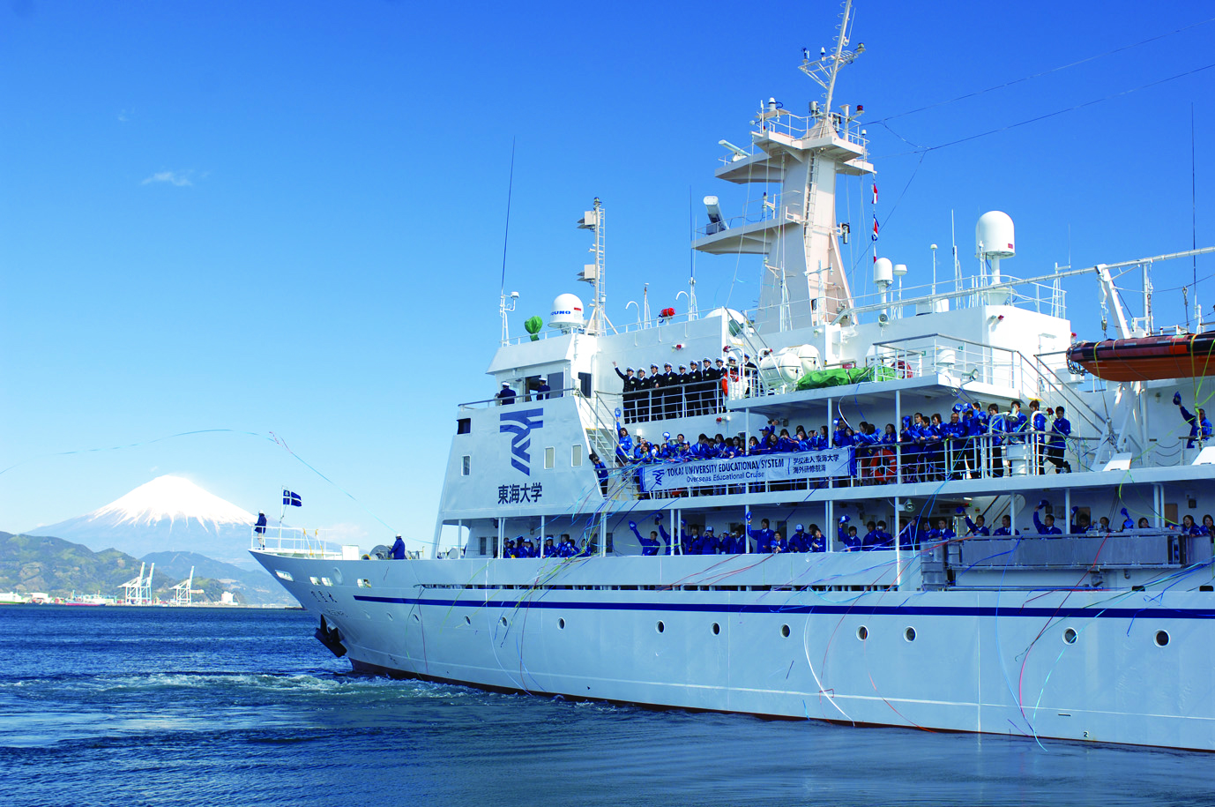
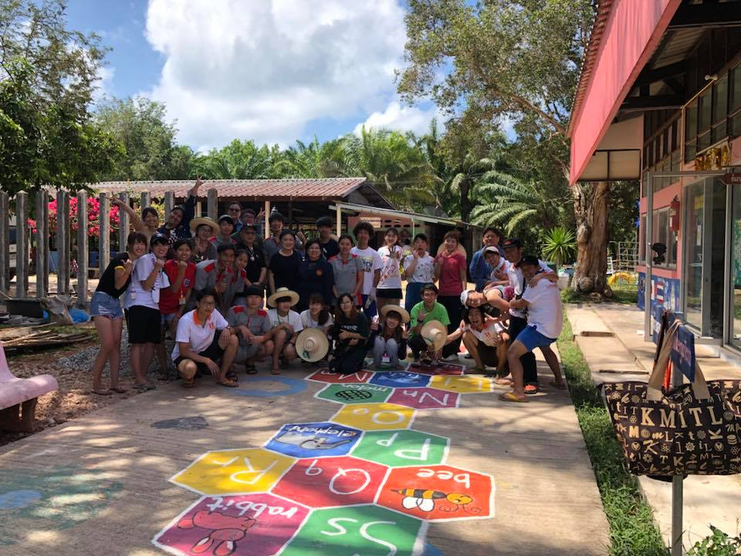
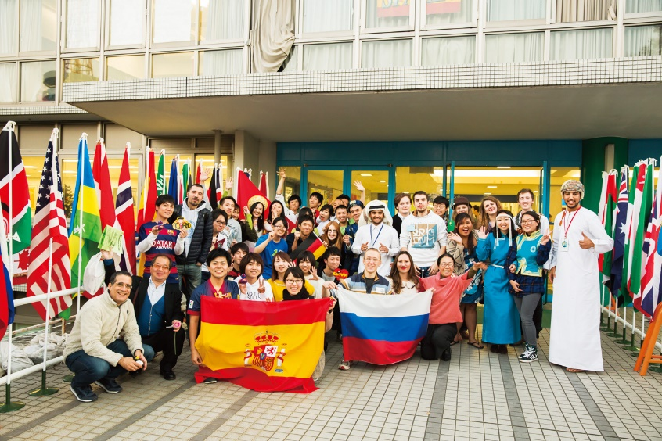
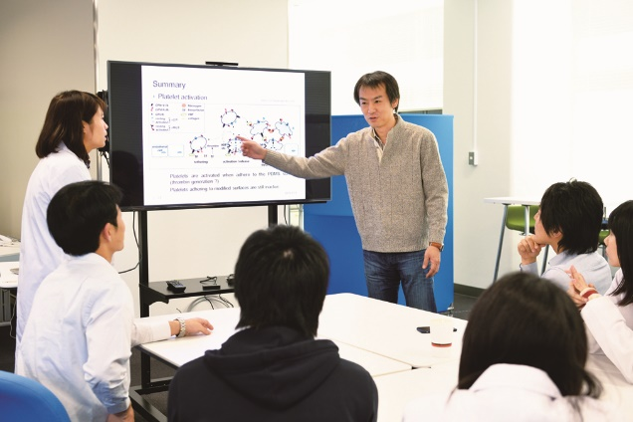
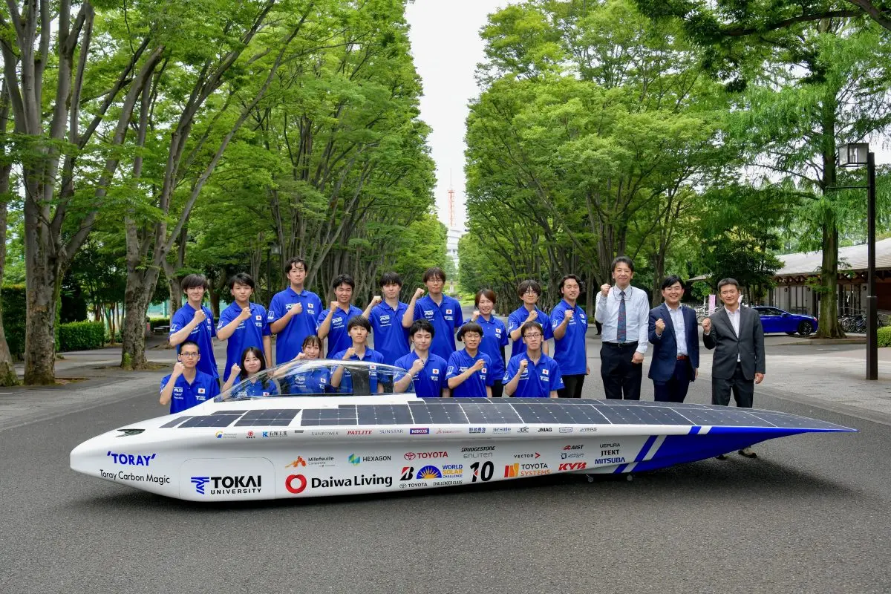
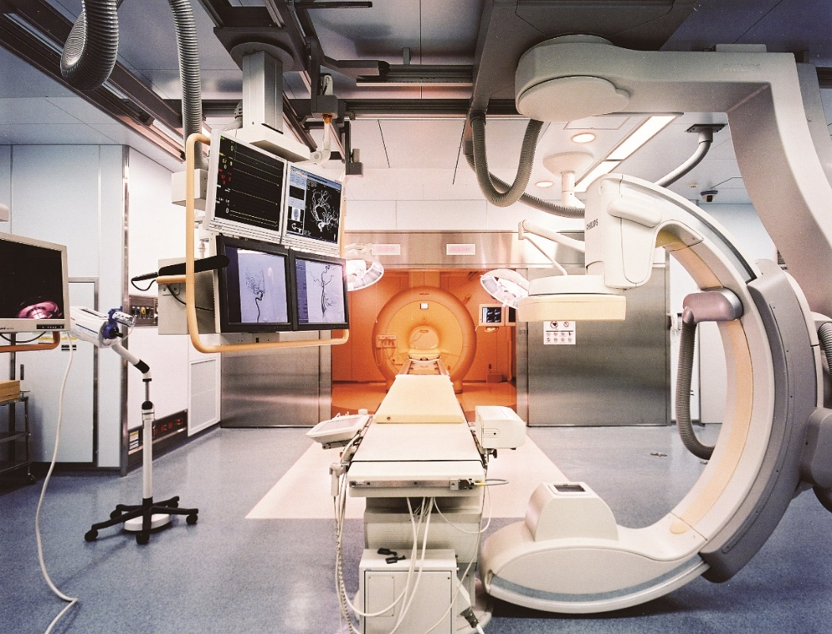
Tokai University
［Tokai University ASEAN Office］
Contact address: 18/8 FICO Place, 3F Room 301, Soi Sukhumvit 21,
Sukhumvit Rd., Klongtoey Nua, Wattana, Bangkok, 10110
Phone: 02-661-7161, 02-329-8158 E-mail : tokaiasean@gmail.com
URL : http://www.u-tokai.ac.jp
Facebook : http://www.facebook.com/tokaiasean/
LINE official account : TokaiAsean_Office (@392pvkpf) Instagram : tokaiasean
Introduction
Tokai University is a private university which was established by Dr. Shigeyoshi Matsumae in 1942 and celebrated its 80th anniversary in 2022. It is one of the largest general education and research institutions in Japan today, consisting of 7 campuses spread over the country. The 23 schools made up of 62 departments offer a vast variety of majors and programs, and have a combined population of 30,000 students, with its graduate schools offering an additional 40 programs. As of May 1, 2025, 2,396 international students from 42 countries are studying at Tokai University.
～ Think Ahead, Act for Humanity ～
The Educational Creed
Cultivate your thoughts in your early days
Nurture your body in your early days
Develop your intellect in your early days
Aim your hopes towards the stars in your early days
Major Activities
Shonan campus
Training and Research Vessel BOSEI MARU
Strong Partnership with
Thai Universities
Tokai University commenced its relationship with Thailand in 1965 through the Overseas Technical Cooperation Agency (superseded by JICA). Since then, more than 700 exchange students have studied at Tokai University, returning to Thailand after achieving their Doctorate and other degrees/ certificates.
Exchange Program
Through partnerships with more than 120 universities and institutes in around 40 countries, Tokai University offers approximately 60 internship and study abroad programs.
Diverse Fields of Innovative Research and Application
Tokai University encourages cutting-edge research for the next generation in a variety of fi­elds, centering on nanotechnology and life science. Also, the university promotes collaboration among industry, government and academia by taking advantage of the wide range of schools that comprise the university.
Program for International Students
The Graduate School of Engineering offers courses taught in English. This program is specifically designed for international students from all over the world to acquire the research techniques and theories in their particular fields of study in engineering.
Volunteer camp with KMITL students
International Fair at Shonan Campus
Micro/Nano Technology Center
Tokai University Solar Car Team
MRXO at Tokai University Hospital
Notes:
●ヘッダとフッタの背景、枠線は変更できません（スライドマスタで設定しています）。
●色の半透明効果はなるべく使用しないでください（出力トラブルを招く場合があります）。

